Slide 1
DesignPlus & Multitool by CidiLabs
March 2024
An Introduction & Demo
Michelle fulks read, phd, cfd
Instructional Designer, The University of Texas at Austin

Slide 2
Why DesignPlus?
Relatively easy interface.
Potentially creates easy navigation.
Allows for organization of information that is consistent from page to page, module to module.
Creates aesthetically pleasing results.
Provides some interaction (e.g., accordions, tabs, quick checks).
Allows editing of individual segments (or dividers) of information.

Slide 3
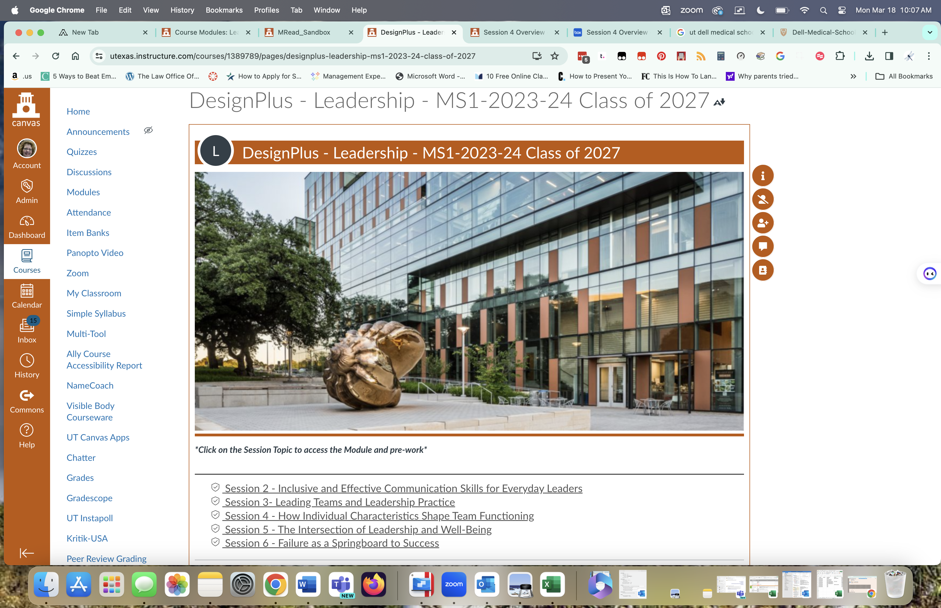
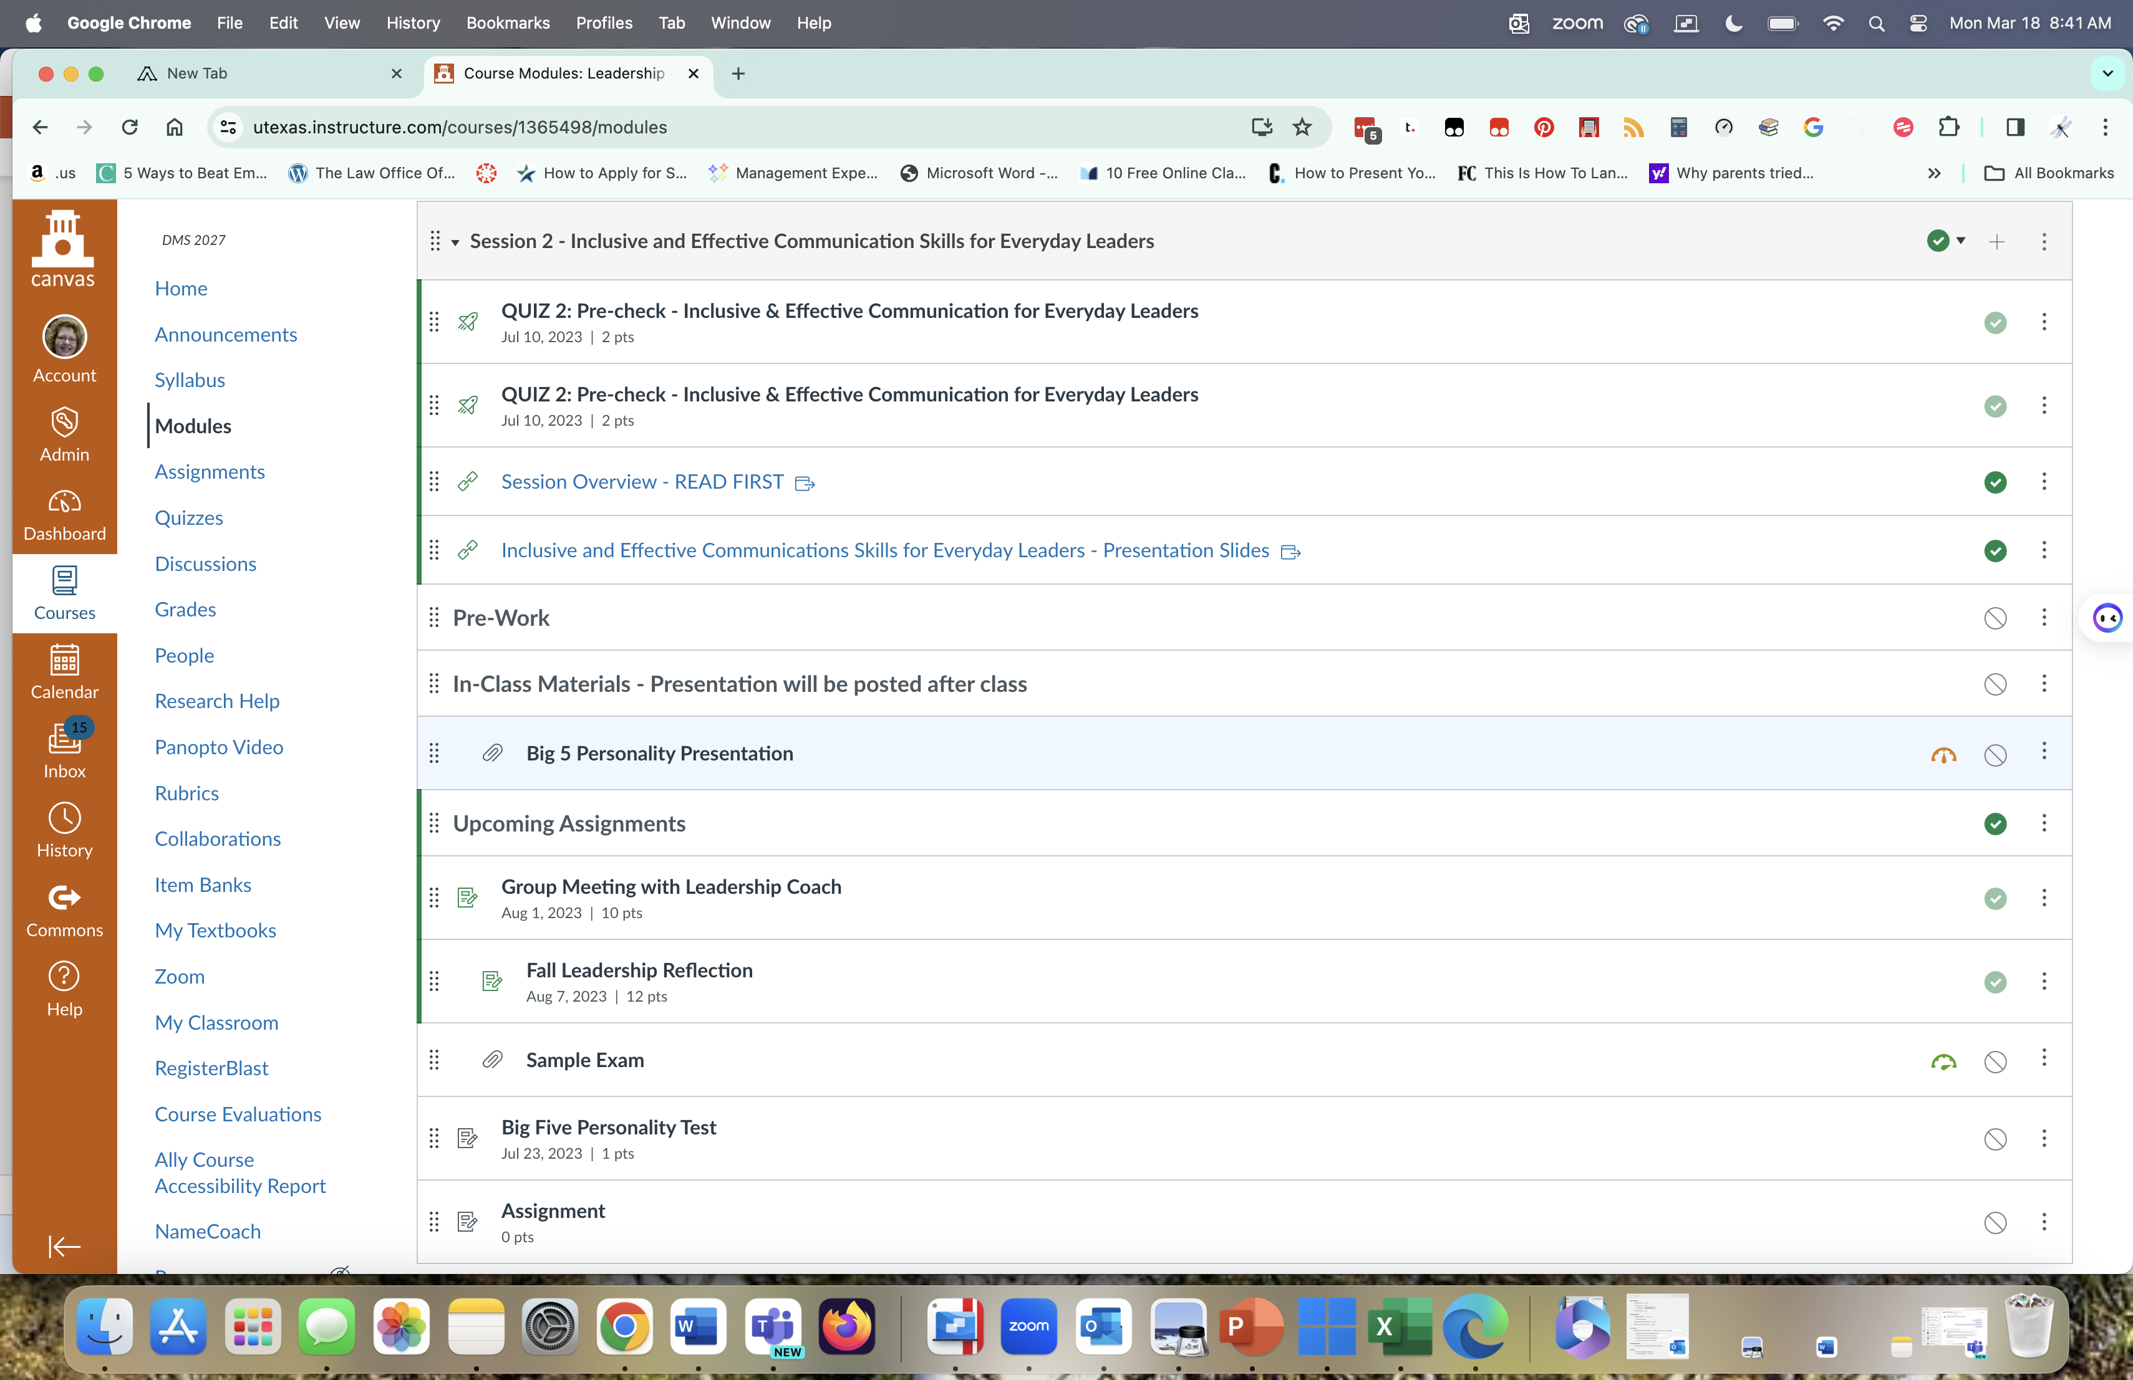
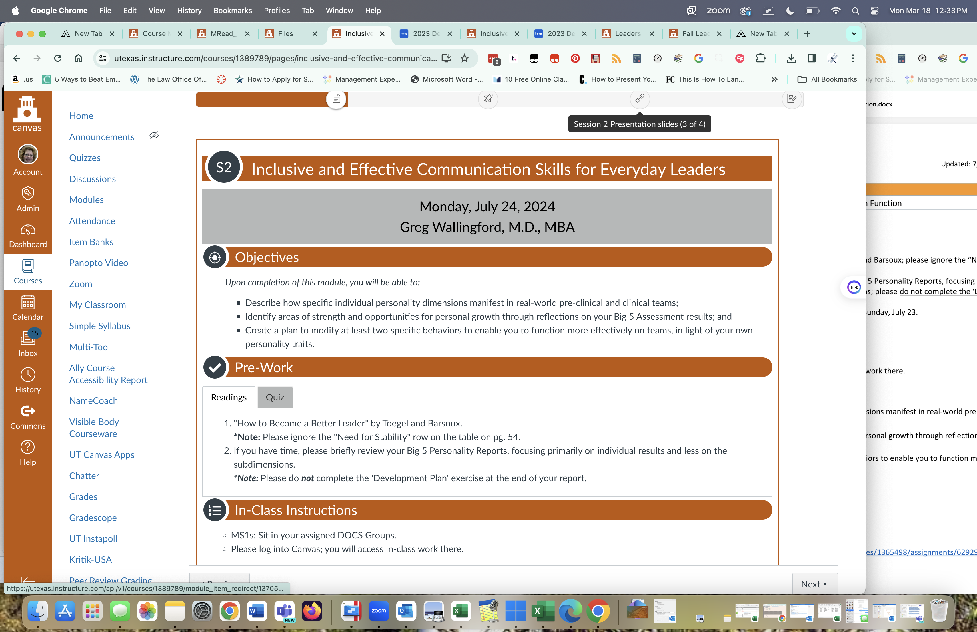
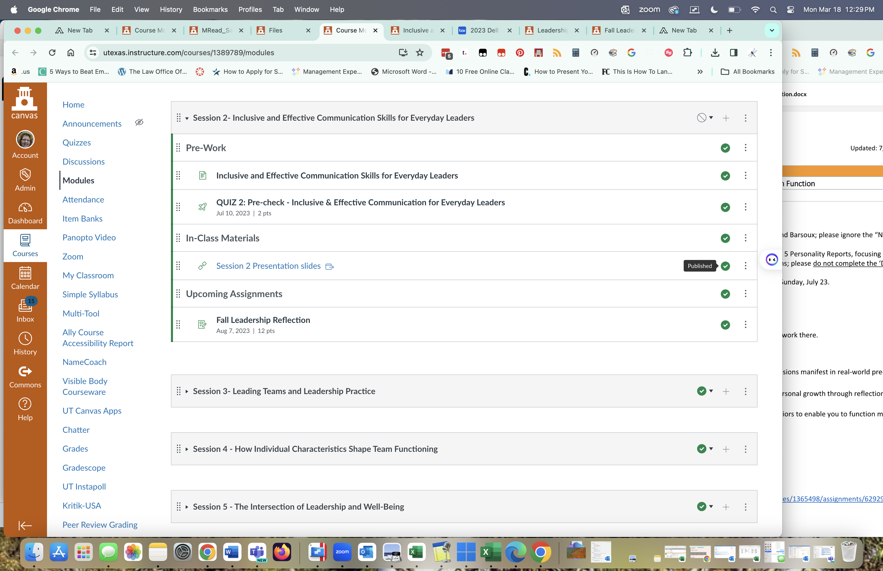
Without DesignPlus vs. With DesignPlus

Slide 4
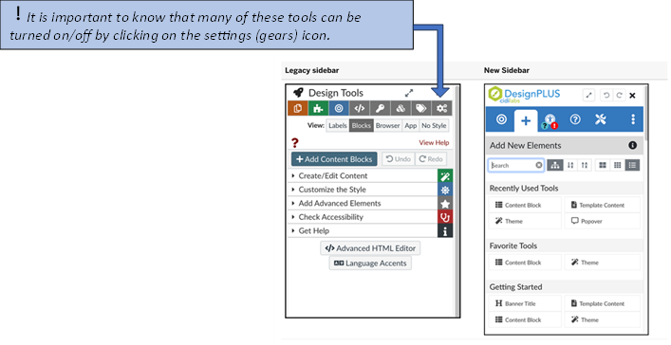
Legacy Tools

Slide 5
DesignPlus Toolkit Demo

Slide 6
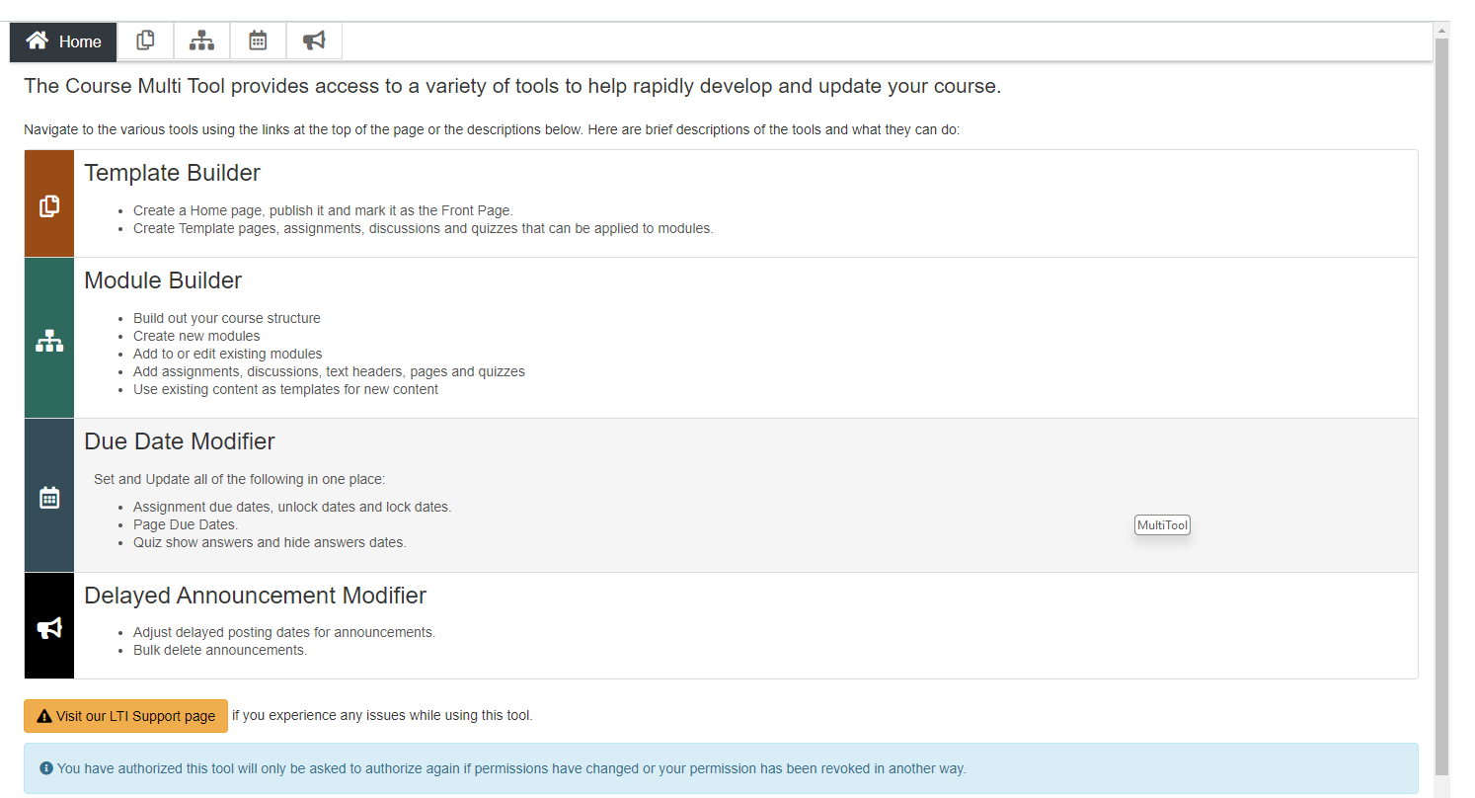
MultiTool
Also by CidiLabs.
To activate, go to Settings>Navigation and drag to the top set.
Save.
Open from course nav.
Activate.
Not seen by students.

Slide 7
Why use MultiTool?
Creates templates for pages, assignments, discussions, and classic quizzes (not New Quizzes) so you don’t have to remember what your previous pages, etc. looked like…simply apply the template you made once.
Creates straightforward module templates that is easily duplicated for the number of modules you need.
Edit the names of modules all at once.
Modify dates all at once.
Create announcements in advance.
Students like consistency in the look and feel of their online courses.

Slide 8
Template Builder
Build templates before module patterns!
Create a unique Homepage.
Create a template for:
Content pages
Assignments
Discussions
Classic Quizzes
Strive for organizational consistency that helps you (and students!) see the connections.
Limitations:
Does not work well with New Quizzes.
Cannot be applied to pre-existing pages, assignments, discussions, or quizzes.
Templates are simply pages, assignments, discussions, or quizzes. In other words, they show up in the lists of those content types and themselves can be edited by any site editor.

Slide 9
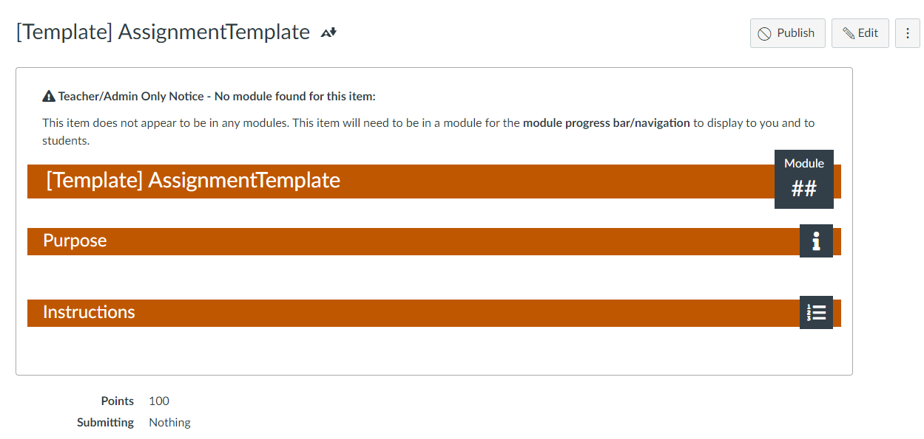
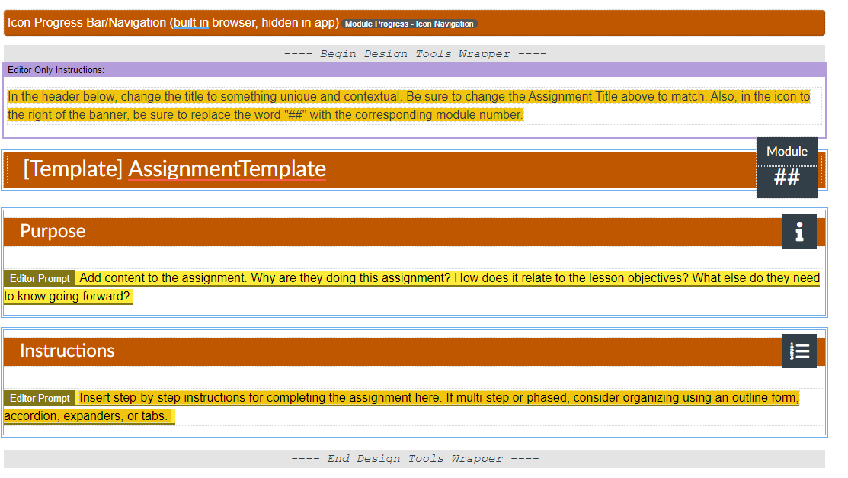
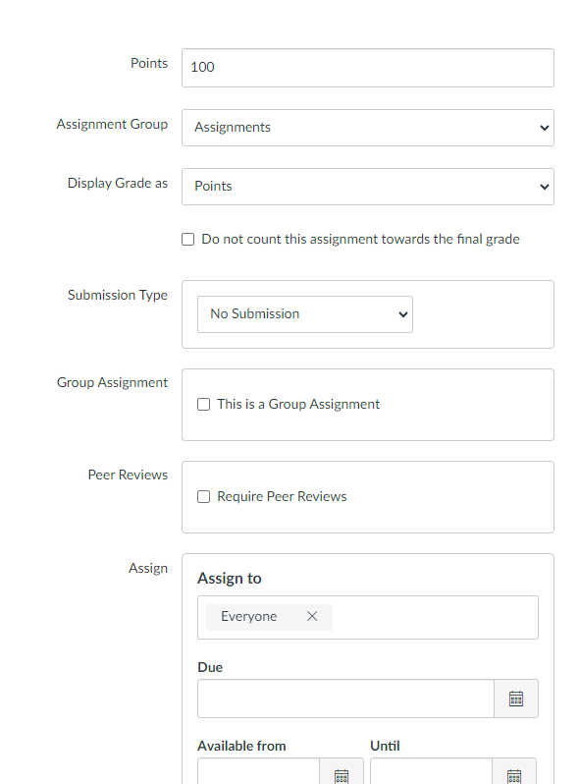
Build Templates
Under “New Template”, provide a name for whichever template type you want to create.
Click “Create Template Page”.
Open the template page to edit from the list that grows below.
Design Tools automatically opens with the editing screen.
Begin designing. Consider adding editor notes (only seen by editors) under “Add Advanced Elements>Key Action Items”.
Only add the information such as points, assignment groups, submission type, etc. if you want that information to be true for ALL assignments (i.e., all assignments are worth 100 pts), or all discussions, or all pages, or all quizzes; else create unique types of those content page templates. (ex: Group Discussion Template).

Slide 10
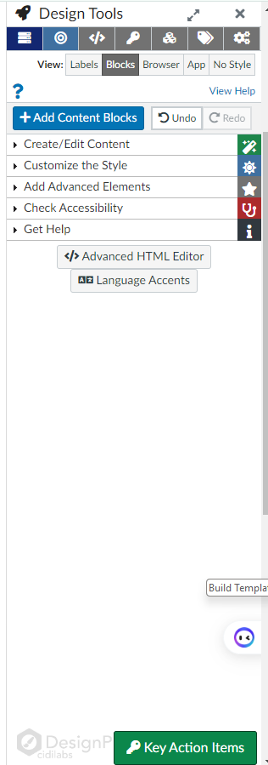
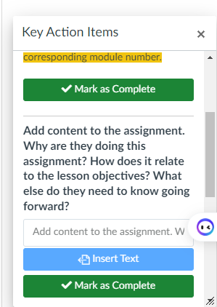
A bit more about Key Action Items
When Key Action Items are present, a green button appears in editing mode at the bottoms of the Design Plus Tools panel. Other editors can use that to readily see the list of items on the page and mark them as done.
Limitations: 1. Design Plus might allow adding content directly above the “Mark as Complete” button, but it will not format.
2. By clicking “Mark as Complete”, the key action item disappears from the editor’s view too.

Slide 11
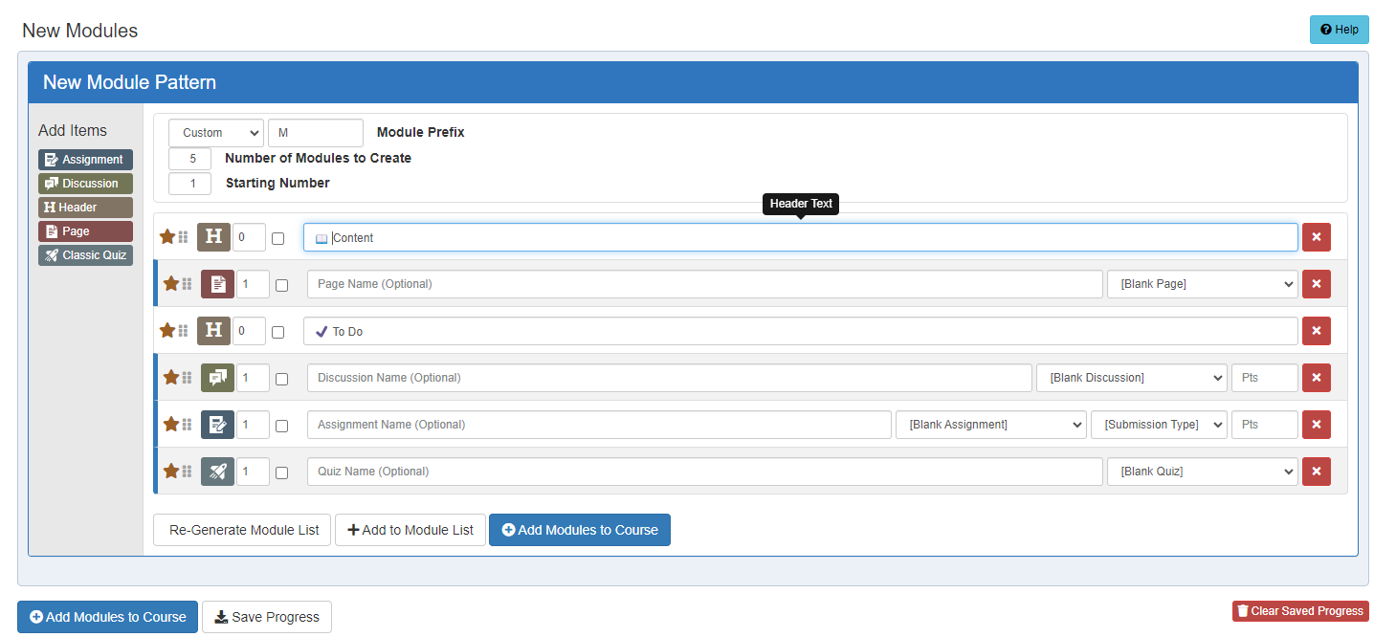
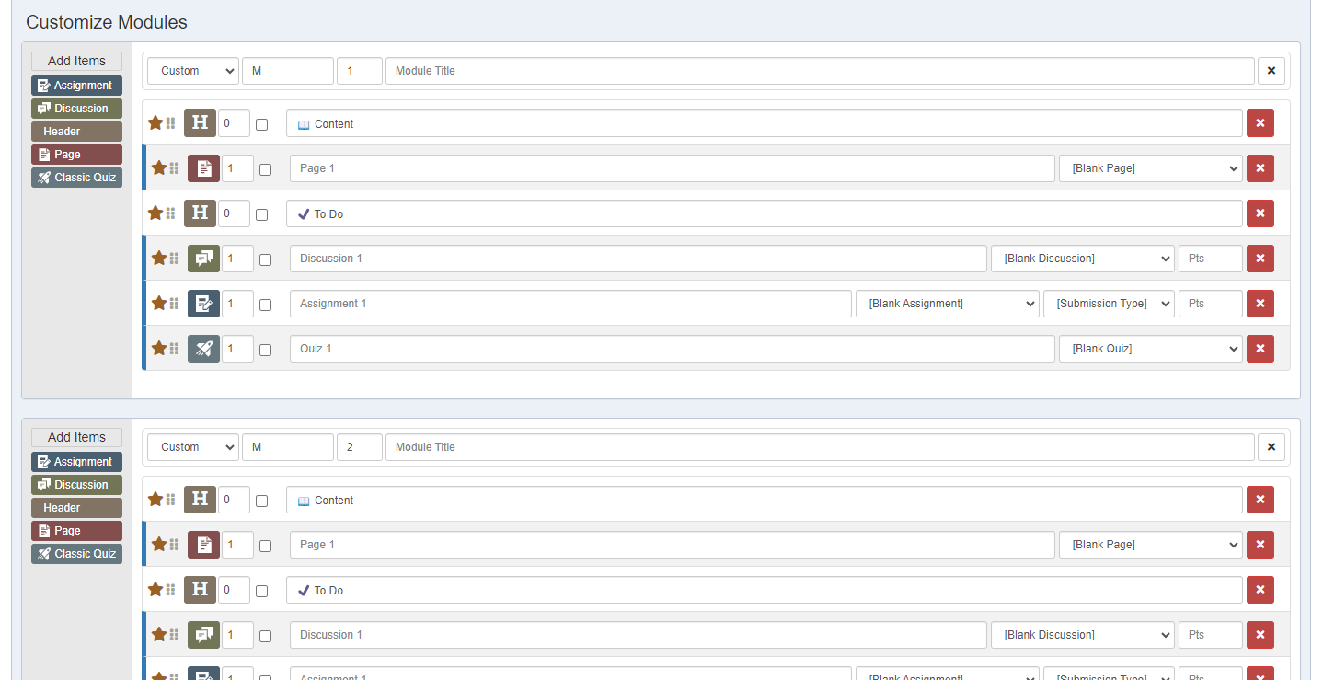
Module Builder
Create a module pattern.
Limitations:
Build
1. Module Prefix: What do you want to call your modules (if anything)?
2. How many modules do you want? This can be changed later.
3. What number should be first?
You can use negative numbers.
Arrows use increments of 1, but you can type in decimals like 1.5.
4. Begin adding module items in a specified list. Such as a header, page (for content), maybe another header to separate module content from module activities, discussion, assignment, quiz. If existing pages, discussions, assignments, quizzes exist a drop down appears.
5. Click “Generate Module List”.
6. If desired, customize each module, such as providing each unique module a title to follow the prefix and number.
7. Click “Add Modules to Course”

