Slide 1
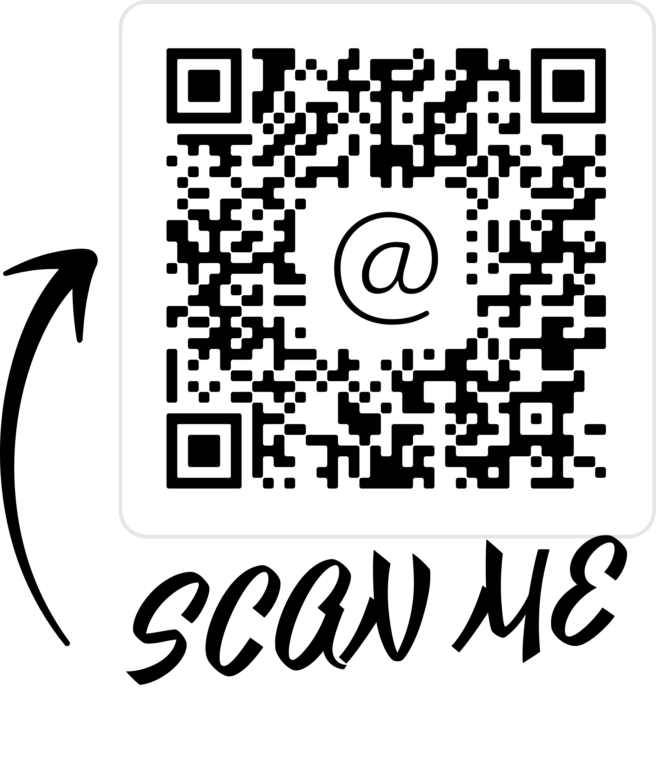
Need Help?
More information, including basic troubleshooting tips can be found on the Med Ed Instructional Technologies pages. Click or scan the QR code below for more. | Non-emergency – IT email help@dellmed.utexas.edu 512-495-5888

Slide 2
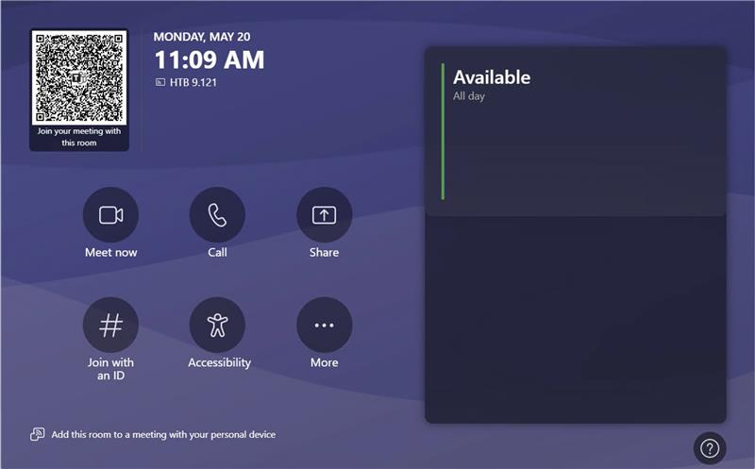
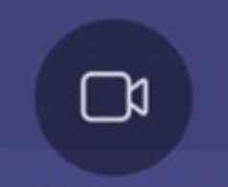
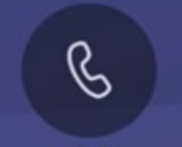
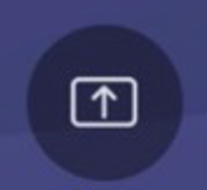
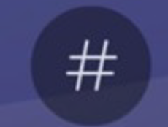
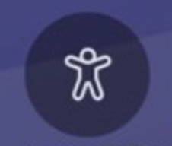
Controls for Teams Rooms (Conference Rooms; Small Group Rooms)
The Crestron panel in this room is simple and small with either the device itself mounted on the wall next to the BenQ Interactive board or attached from the wall to the conference table. There are two primary purposes to these rooms: a) share content from one’s personal laptop and/or b) connect to others not physically present in the room through audio-video conferencing tools, Teams and Zoom.
*Note – In a recent update, Microsoft has added a QR code to the screen allowing others in the room to quickly scan and join from their own devices.
To the right on the Crestron interface, you will see any scheduled meetings for the room using the Teams video-conferencing feature.
Share guests’ local content. Connect
Forgot to schedule a room? Start one now and send the invitation info to your guests.
Need audio, but not video? Make a simple call here.
the laptop to be shared to the HDMI cable and click here. Be sure to click here again to stop sharing before disconnecting the laptop.
Joining someone else’s meeting? Connect with the meeting ID.
Need live captions? Click here.
Click here for more tools, such as resetting the system when things aren’t working.

Slide 3
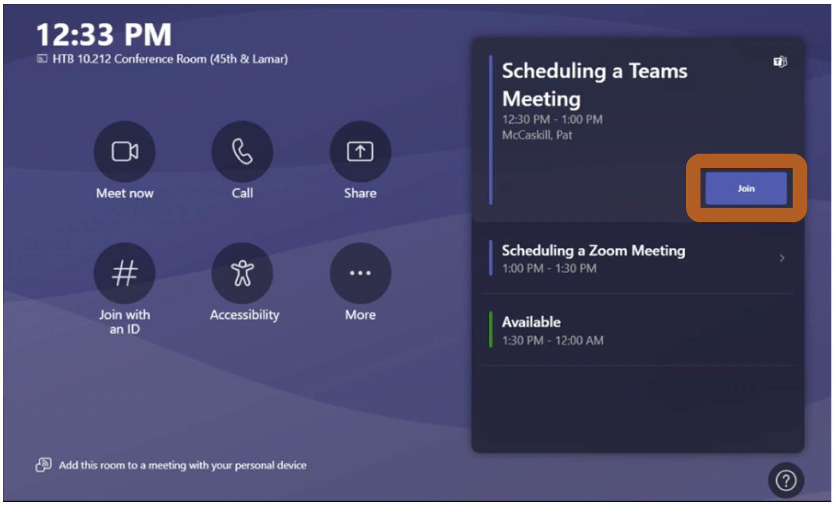
Joining a Previously Scheduled Meeting
Each Teams Room has a touch control panel that shows the scheduled meetings.
Locate the touch control panel and press the Join button when it is time for your meeting to start.
To learn more, click the QR code, or scan it with your
mobile device camera.
Meet Now
Join with an ID
Share
More
“Meet now” will start an ad-hoc Teams meeting where the room is the meeting host.
“
“Join with an ID” allows the room to join another existing Teams or Zoom space by entering the meeting ID.
“
“Share” will toggle on/off the sharing of locally connected devices.
“More” shows additional room settings. From here, you can reset the equipment if there are any issues.

Slide 4
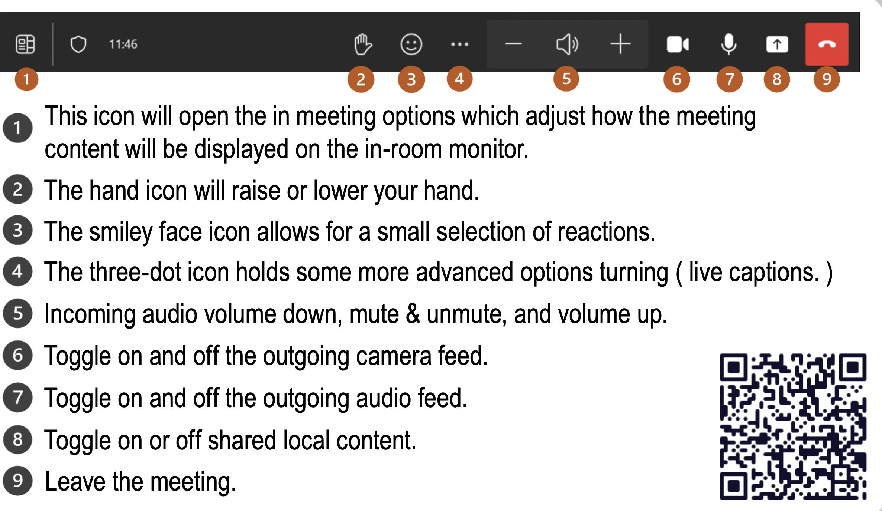
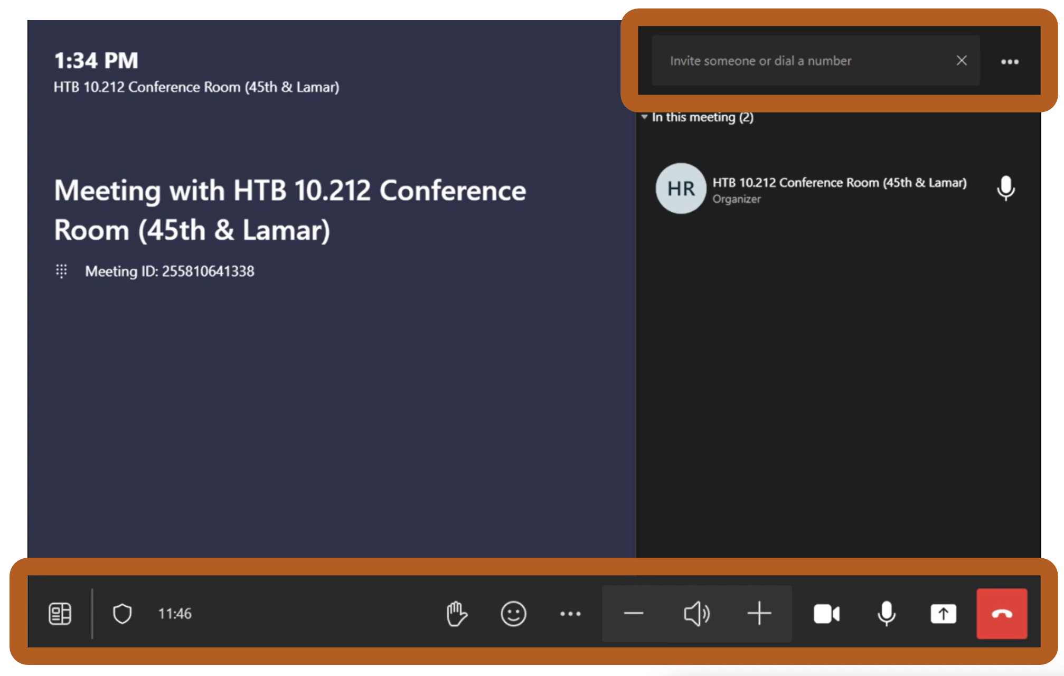
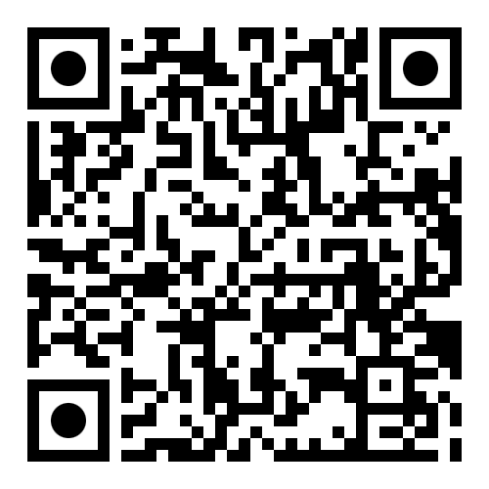
In Meeting Options (Teams)
1
2
3
4
5
6
7
8
9
To learn more, click the QR code,
or scan it with your
mobile device camera.

Slide 5
Schedule Your Teams or Zoom Meeting in Advance
1
Reserve your room. To reserve your meeting space, start by drafting a calendar invite within Outlook.
2
Add your desired meeting space as a location. Double check that the meeting space is also added as a required attendee. (Outlook should do this automatically).
3
Add your Teams or Zoom meeting details into the body of the Outlook event. Meeting details can be generated from the Zoom/Teams Outlook Plugins or from the Zoom/Teams desktop applications.
If the meeting space is available during your selected time, the booking will be approved, and your meeting will then be scheduled.
4
In MS Outlook, assuming the plugins are installed:
In the location field, add an HLB room and then click on the Teams Meeting toggle switch.
In the location field, add an HLB room and then click on the ellipsis in the toolbar and click Zoom> + Add a Zoom Meeting.
Once either the Teams or Zoom plugins are activated, they will auto-generate meeting information and place it in the body of the event email.

Slide 6
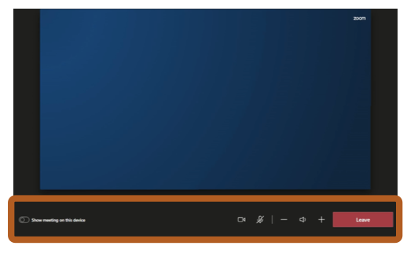
In Meeting Options (Zoom)
Teams Rooms do support joining Zoom meetings; however, it does not share all of the same features.
IMPORTANT: Sharing local content is not supported in a Zoom call from the panel.
To share your screen in Zoom: Join the same meeting (check for matching Meeting IDs) from your laptop and share from the laptop application.
When doing this, do not join audio to avoid audio feedback and echoes.
To learn more, click the QR code,
or scan it with your
mobile device camera.

Slide 7
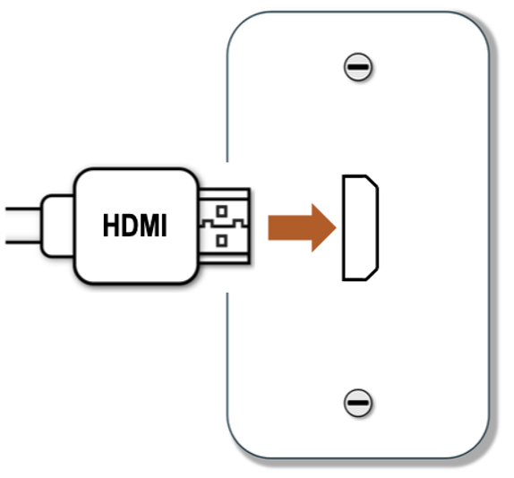
Sharing Local Content (HDMI)
HDMI capable meeting rooms will have an HDMI wall plate where you can plug in your laptop.
Larger conference rooms will have an HDMI cable routed to the conference room table.
Connect your laptop to the room’s video system at the wall port or conference table HDMI cable. (Adapters are provided if needed)
Once physically connected, you can share your content on the room’s display and in a meeting.
On the room’s touch control panel, use the Share button to start or stop the shared screen.
*Note: Toggle off the Share button before connecting another device.
*Note: Test your connections before important meetings. Not all devices are compatible.

Slide 8
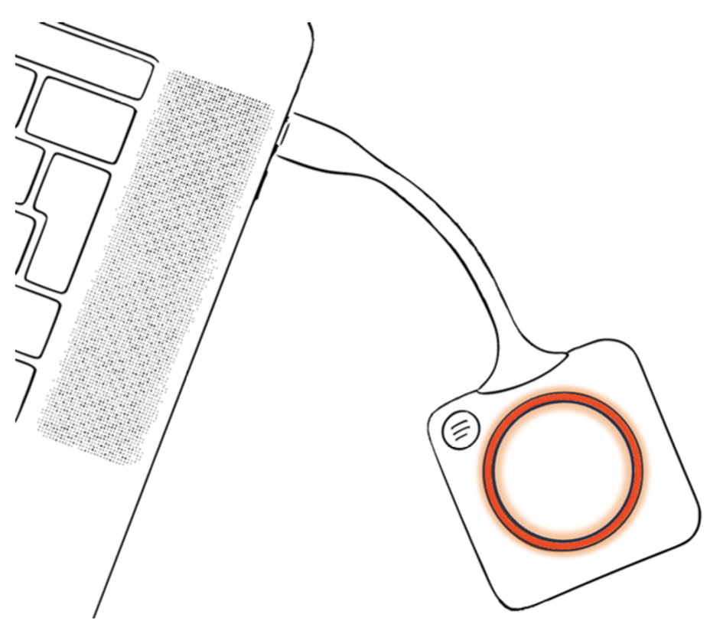
Sharing Local Content (ClickShare – USB-C only)
ClickShare is an adapter with a wireless connection to the video system.
Start by plugging in the Clickshare dongle into your laptop’s USB-C port.
First time users will need to wait up to 1 minute for the dongle to pair.
The lights around the button will flash white, then stay solid white when ready.
Click the large center button to share your screen with the video system.
Multiple users can share at the same time!
*Important: Some laptops will not pair unless connected manually. Click or scan the QR codes above for more information.

Slide 9
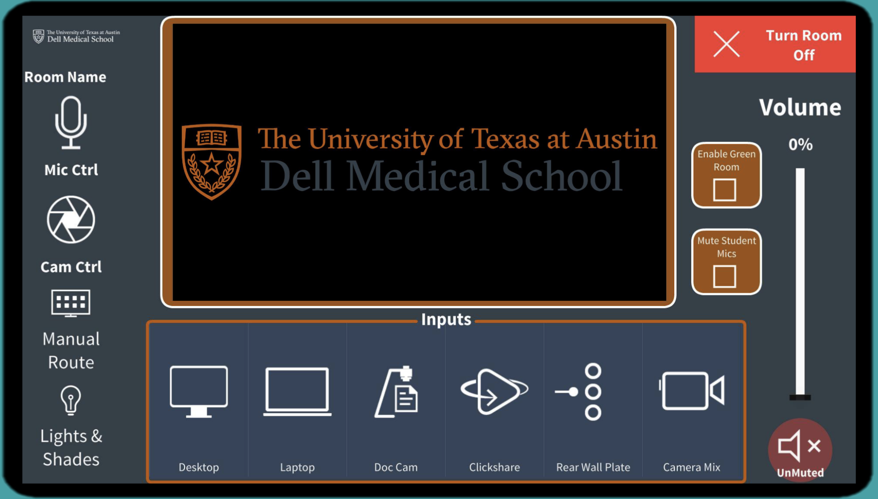
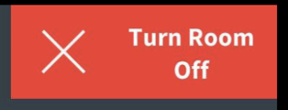
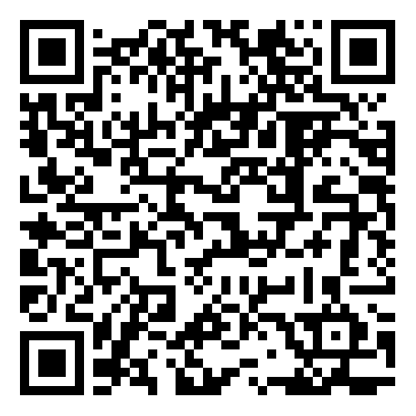
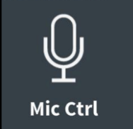
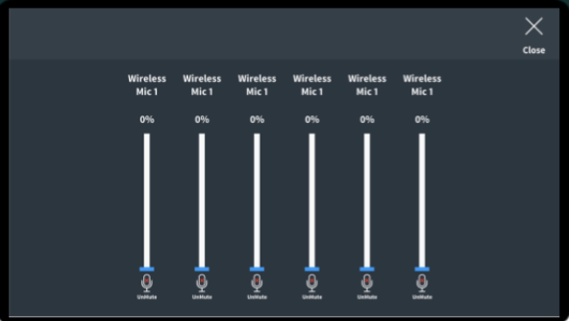
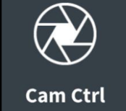
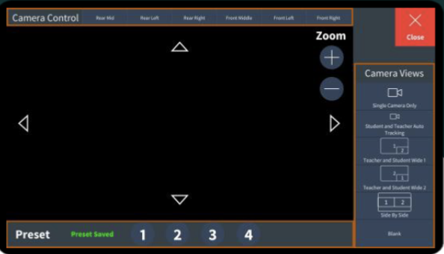
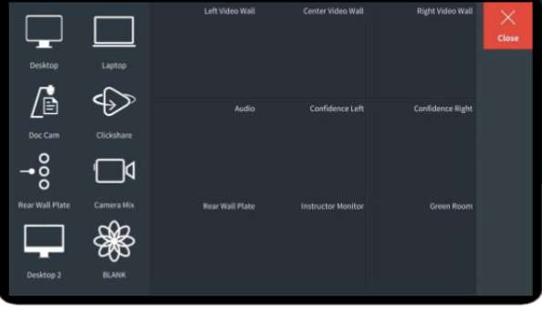
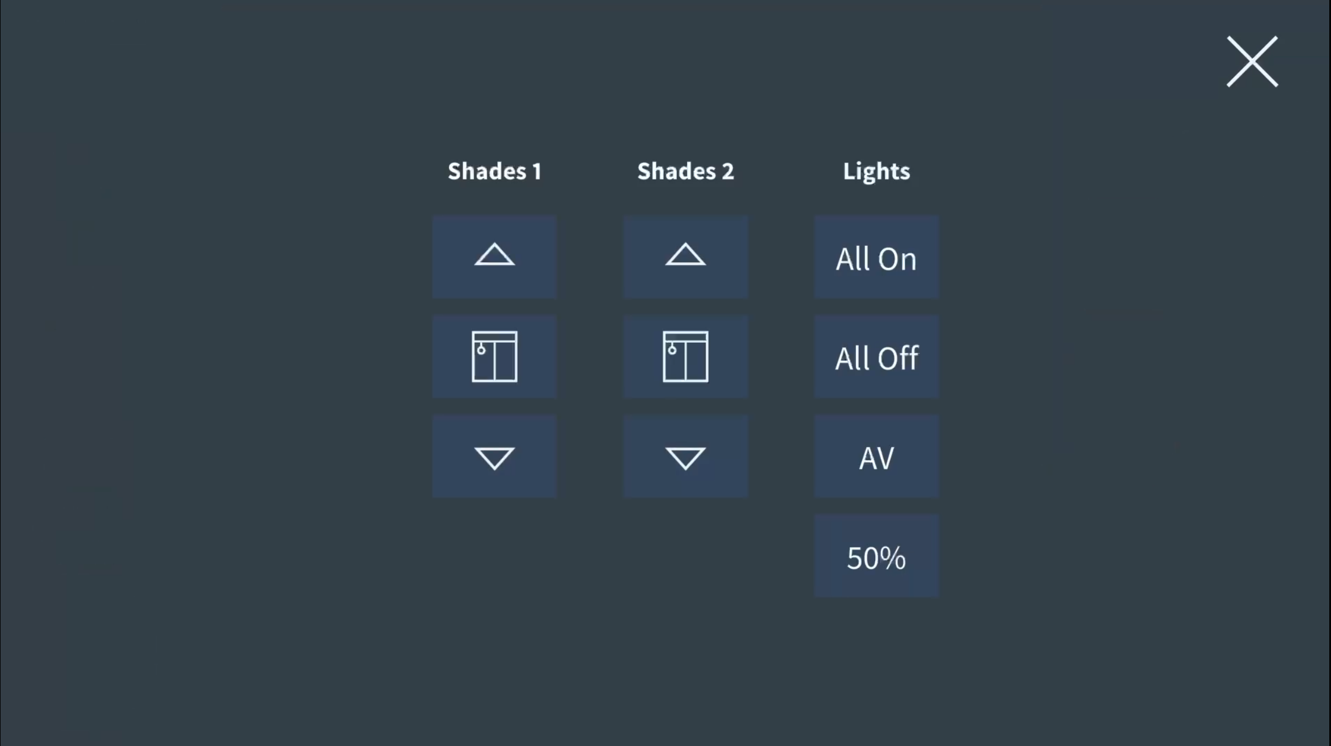
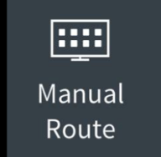
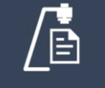
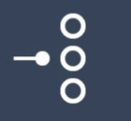
Crestron Controls for the Auditorium
Crestron Controls for the Auditorium
To begin, turn the room on. Be sure to turn the room off when you are done.
Mute/open all student mics.
Use the main panel volume slider to control the overall room volume.
Enable/disable the Green Room feed.
The screen space shows the current content. A monitor next to the panel displays the extended auditorium’s main computer or attached laptop screen. Three large displays screens hang on the wall, while two additional confidence screens face the presenter from the floor in front. There is also a green room controlled by this panel.
The Crestron panel controls what content is displayed where and allows installed camera, light, and mic controls.
To learn more, click the QR code, or scan it with your mobile device camera.
Desktop – the room’s computer.
Laptop – one’s own device connected
via the HDMI cable.
Any device plugged into the back wall plate. (Seldom used).
The doc cam to the left of the Crestron panel.
Clickshare devices.
Camera Mix.

Slide 10
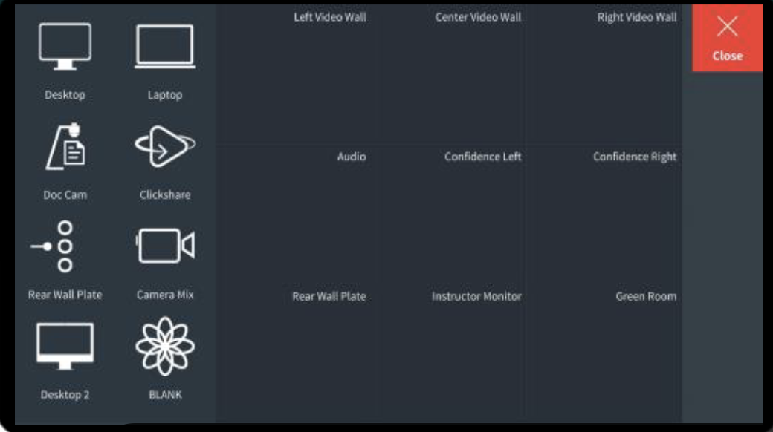
Crestron Controls for the Auditorium (Manual Route)
When you select Manual Control button on the main Crestron screen, you open a window that allows you to simply drag and drop the input of your choice to the display of your choosing. For example, if you want to display the content of the doc cam on all displays, simply drag the doc cam icon, located on the left, to all the displays as labeled on the right, one-by-one. If you change your mind about displaying the content on one of the devices, simply drag and drop it back in the device list. When you have made your selections, click “X Close” to go back to the main Crestron screen.
Devices
Displays
Drag and Drop
*Important: To send a device signal to the Green Room, be sure to enable the Green Room on the main panel.

Slide 11
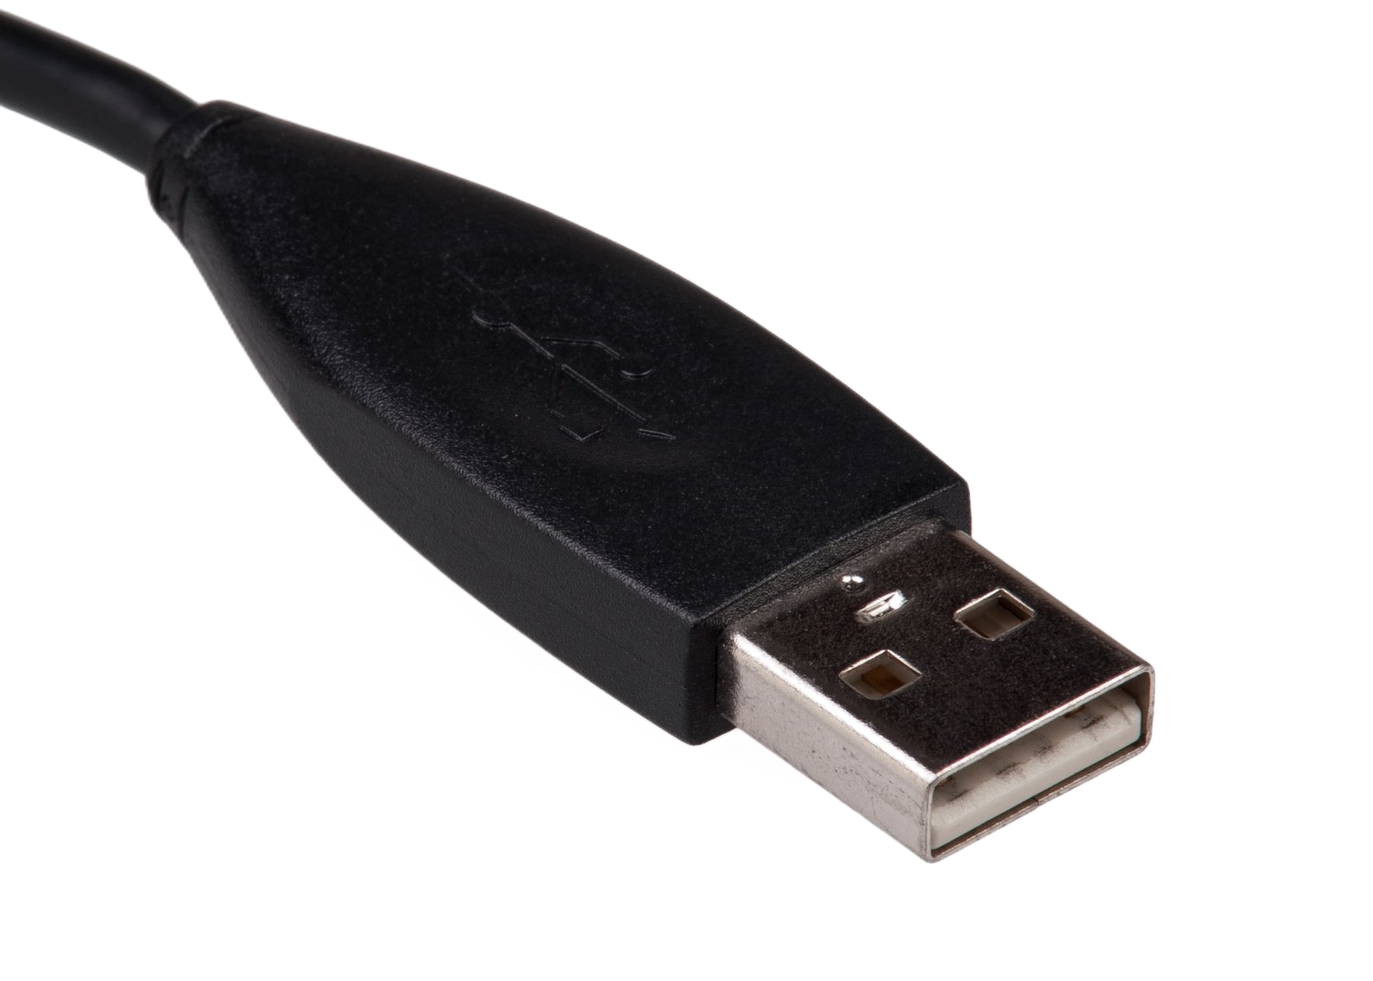
Crestron Controls for the Auditorium (Connecting your laptop & Video-conferencing)
HDMI
When you'd like to use your laptop as a source in the auditorium, you will do so by plugging the device into a cable(s) on the podium. You are provided with a USB-C cable, an HDMI cable, and 2 regular USB-A connectors. Option A: Most newer laptops connect to projection units via USB-C which carries all signals from the laptop to the projection unit in one cable.
Option B: If you need or opt to use HDMI, you will also want to plug in one of the USB-A cables for full functionality.
USB (USB-A)
B
USB (USB-A)
A
USB-C
Once connected, you can share anything from your laptop and even video-conference using your laptop's applications (i.e. Zoom, Teams, WebEx, Google Hangouts, BlueJeans, etc.). Be sure to change to the laptop input on the Crestron control panel.
Click here to learn
more about changing your laptop settings to go through the auditorium equipment.
*Note – you may need to change your device’s system and/or application settings to use the auditorium camera (AJA U-TAP Video 634212) and audio speaker/mic (Dante USB I/O Module) ​

Slide 12
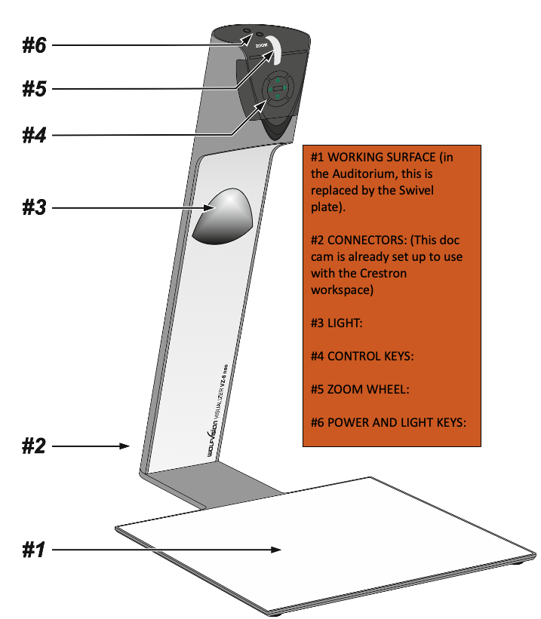
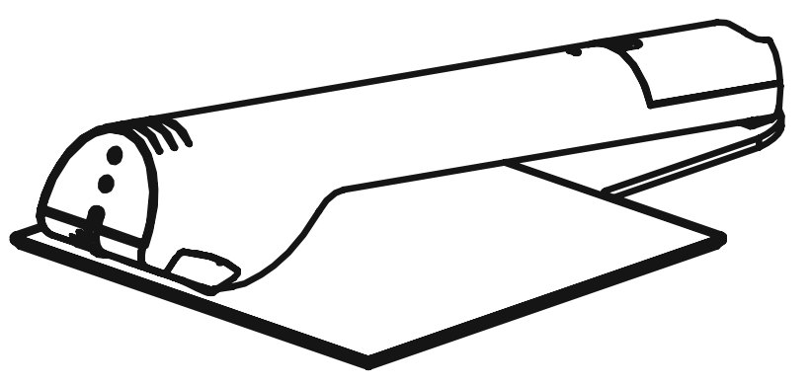
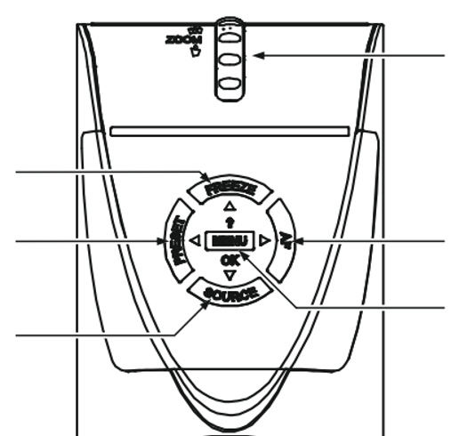
WolfVision Doc Cam (VZ-8neo) - Auditorium
WolfVision Doc Cam (VZ -8neo) – Auditorium
#1 WORKING SURFACE
#2 CONNECTORS: (This doc cam is already set up to use with the Crestron workspace)
#3 LIGHT
#4 CONTROL KEYS
#5 ZOOM WHEEL
#6 POWER AND LIGHT KEYS
The Auditorium has been supplied with a WolfVision Doc Cam already
connected to the Crestron
control panel to easily share
printed materials, 3D objects,
a mobile device, etc. To begin, be sure the Doc Cam is selected for sharing via the Crestron Control panel and lift the Doc Cam arm.
#4 Control Keys
Zoom wheel in/out
Freeze on/off
Autofocus on/off with indicator light.
Presets
Source
Advanced menu
Exterior circular buttons also serve for manual focusing and advanced menu navigation.

Slide 13
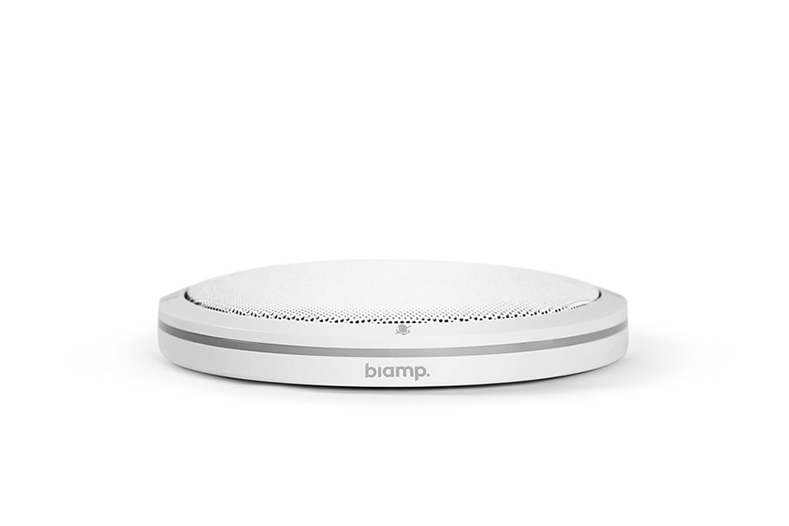
Shure Tabletop Microphone/Transmitter - Auditorium
The auditorium comes with several white disk-shaped mics (2 per student table and 1 on the podium). You should find these devices with a red, muted light indicator. To use, simply tap the side or mic icon to make the red light, green. If too many participants accidentally leave their mics on, you can mute all the participants' mics at the Crestron controller on the home page, or on the Mic Control screen.

Slide 14
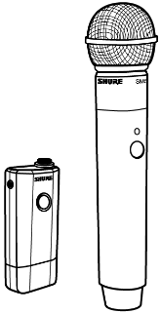
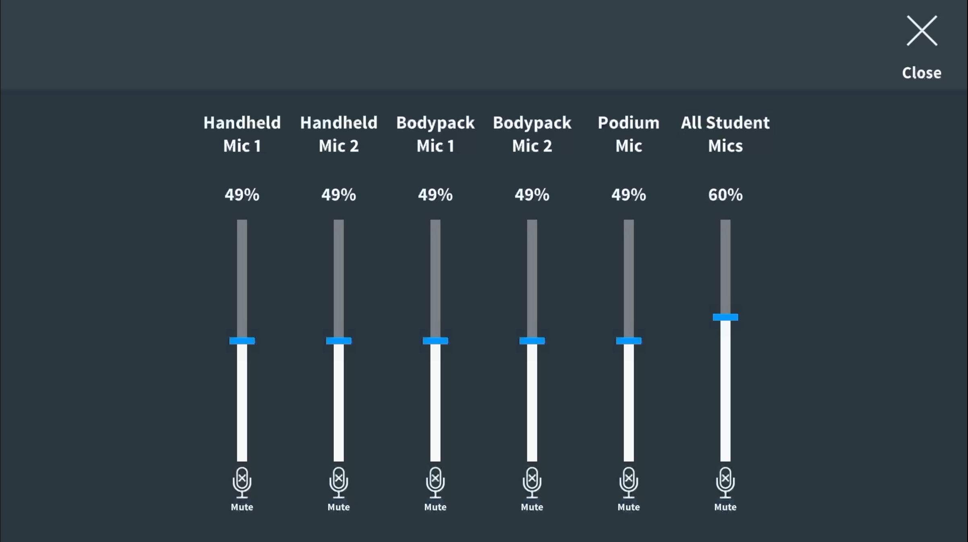
Shure MXW1-Z10/SM58 Microphone/Transmitter - Auditorium
The auditorium is packed with traditional handheld microphones (2) and wearable microphone transmitters (2) on lanyards. To use any of them, simply turn them on and make sure the device's volume is set appropriately under the Mic Controls windows on the Crestron panel.
Important: Don't forget to put the mics back on their chargers before you leave.

Slide 15
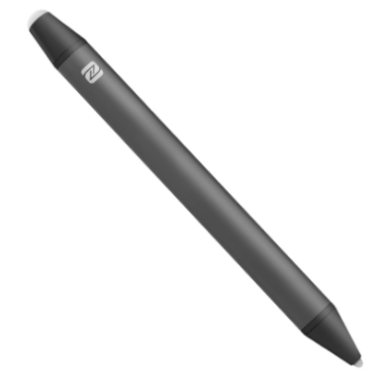
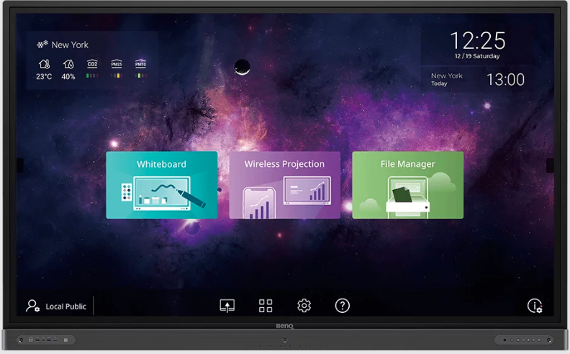
Operating the BenQ Board Device Controls
Do not use ink markers on this board!
The BenQ board homepage displays large quick links to the A) whiteboard feature, B) wireless project feature, and C) file manager. The BenQ boards have two sets of physical controls available at the bottom of the board:
Left – Front ports to plug in other devices as source inputs. Small group rooms/classrooms are provisioned with HDMI cables ready to connect individuals’ laptops. Using any of these ports will require changing the source under the device’s settings.
2. Right – Device controls
A
B
C
1.
Power on/off (Be sure to turn off the
system when you are done.)
4 touchscreen controls duplicate often-used functions.
Upload
Arrange windows (side-by-side or quadrant)
Settings and options
Help
Home screen
Undo, go back a step. Helps navigate through menus.
2.
Board device settings. Options. Account info (if applicable).
Volume. Down.
Volume up.
BenQ RP6503/RP8603 User manual

Slide 16
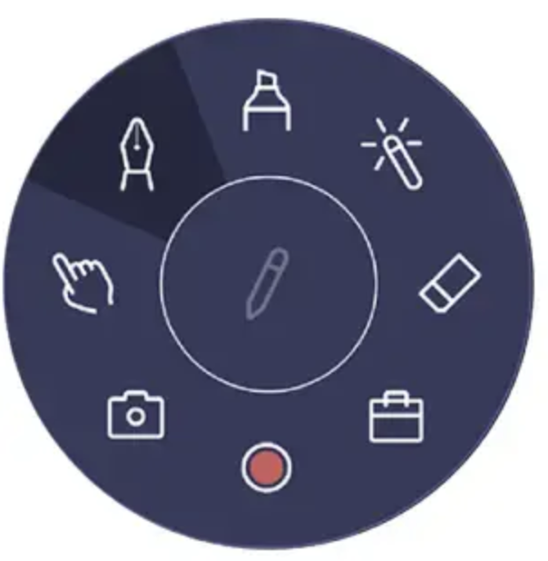
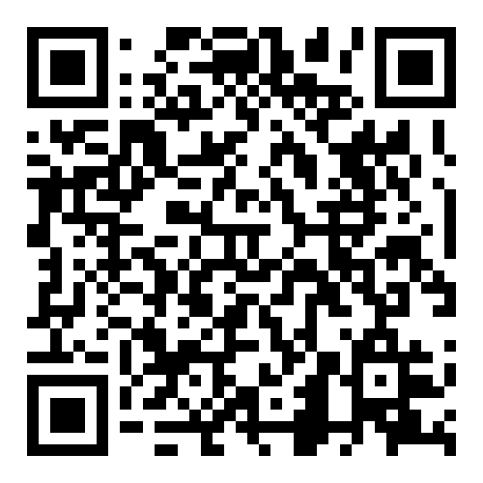
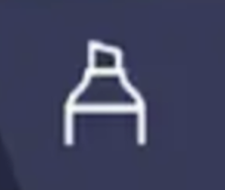
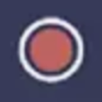
Operating the BenQ Board Floating Controls
Do not use ink markers on this board!
To begin, make sure the board is powered on and press the screen with two fingers until this circular control button appears – it is easily draggable to any position on the board. You can use your finger or one of the provided board pens.
Start/Hide Controls
Click the pencil to begin using the tools. While in use the pencil becomes an “X”.
Clicking the “X” ends the session and makes the controls disappear or minimize to the center pencil icon only.
To learn more, click the QR code, or scan it with your mobile device camera.
Pen
Highlighter
Laser pointer
Eraser
More tools…
Record
Screenshot
Selector
Highlight areas on the board to emphasize displayed content either drawn or displayed on the board.
Use this tool to highlight things without making a mark.
Erase the whole screen or just specific marks made on the screen.
Additional tools include a calculator, timer, ruler, protractor,
Record the actions you take on the board and play the video later* . To take with you, you will need to record the video in play on your own device.
Take a screenshot of what you have drawn and/or annotated and save locally for later use on the same board*. Take a picture with your phone to take with you.
Use this tool to control computer function and objects on your computer.
Use the pen to draw or annotate on a blank board or a board with displayed content.
*Note: There is very limited space on the board's internal memory. If you no longer need it, please delete it.

Slide 17
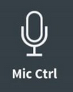
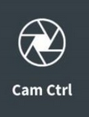
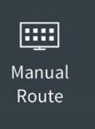
Crestron Controls for the Anatomy Lab
The Crestron panel in this room accommodates seven "Station" inputs – which are the LG display boards. One hangs on the front wall for the instructor and the other six around the cadaver stations. They are labeled to match the panel.
Check "Student Follows" to display the main screen to all displays.
Note: It is best practices to click the red "Turn Room Off" button to reset the system for the next user.
Overall Room Sound Control.
Podium desktop
Clickshare devices
LG Display boards (7)
To learn more, click the QR code, or scan it with your mobile device camera.
Camera mix
A smaller, identical Crestron panel is located by the door.

Slide 18
Crestron Controls for the Anatomy Lab
Devices
Displays
When you select the Manual Control button on the main Crestron screen, you open a window that allows you to simply drag and drop the input of your choice to the display of your choosing. For example, if you want to display the content of the doc cam, or visualizer, on all displays, simply drag the doc cam icon, located on the left, to all the displays as labeled on the right, one-by-one. If you change your mind about displaying the content on one of the devices, simply drag and drop it back in the device list. When you have made your selections, click “X Close” to go back to the main Crestron screen.
To learn more, click the QR code, or scan it with your mobile device camera.
A smaller, identical Crestron panel is located by the door.

Slide 19
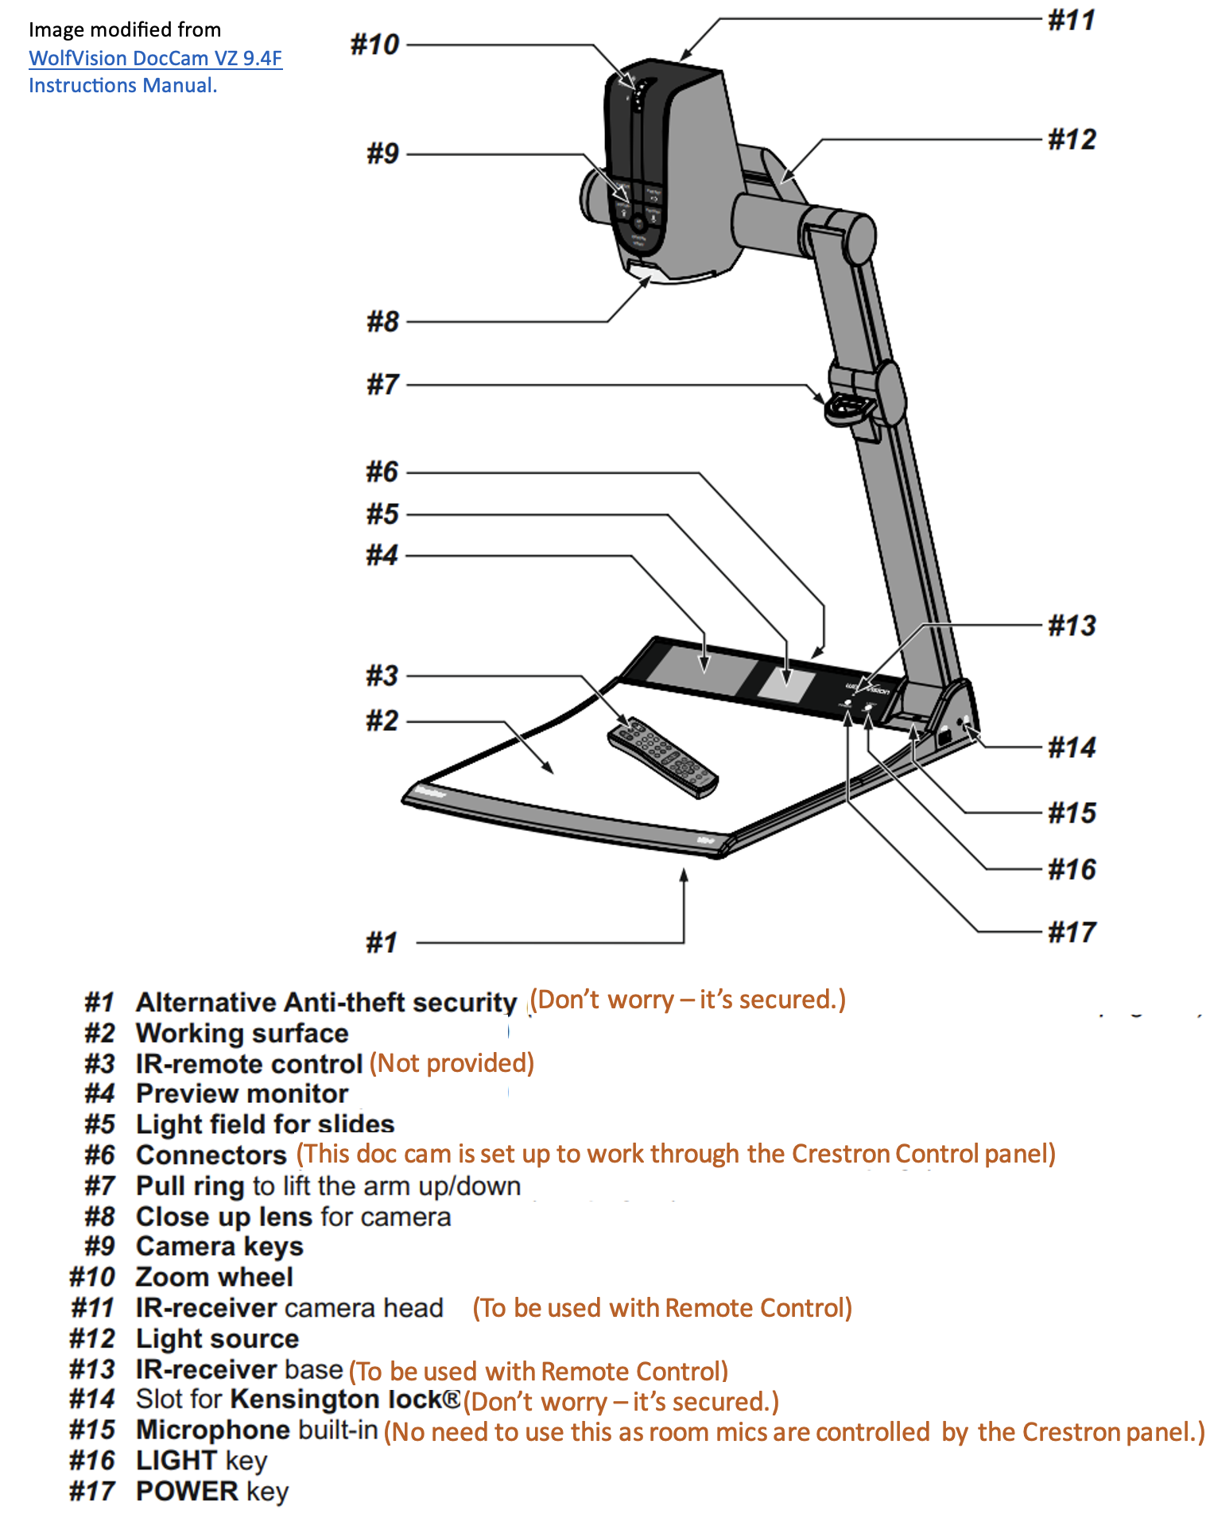
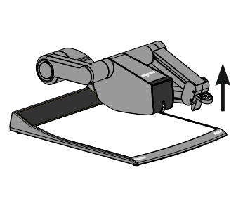
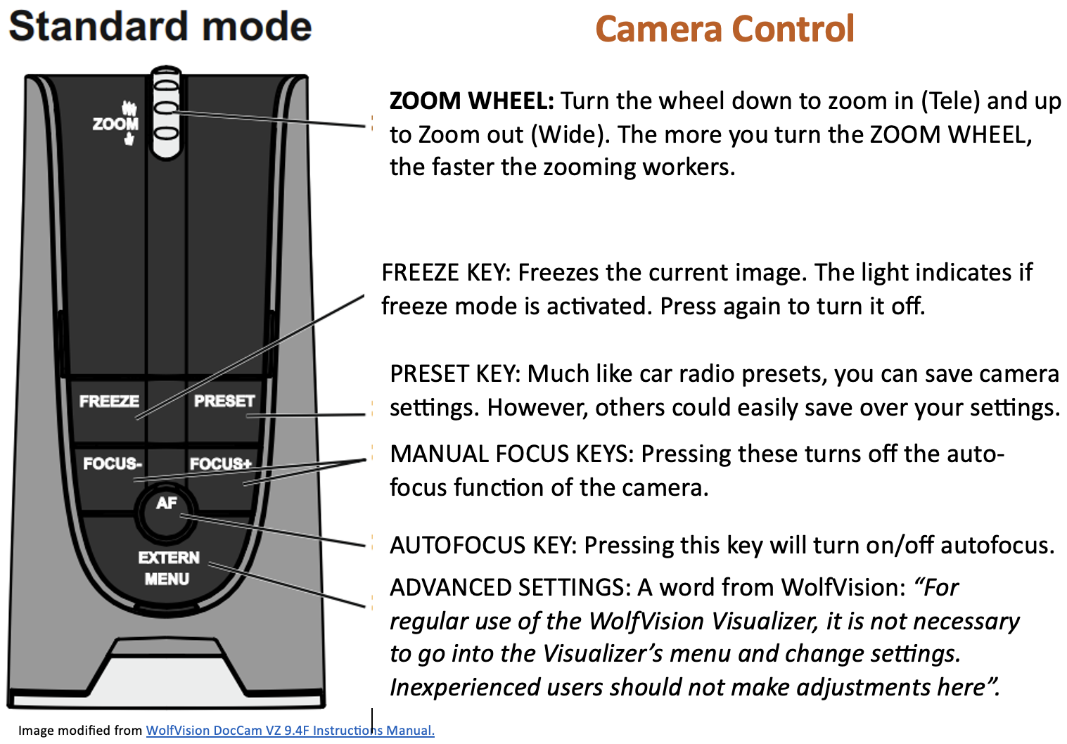
WolfVision Doc Cam (VZ 9.4F) - Anatomy Lab
This room has been supplied with a WolfVision Doc Cam already connected
to the Crestron control panel
to easily share printed materials,
3D objects, a mobile device, etc.
To begin, be sure the Doc Cam is selected for sharing via the Crestron Control panel and lift up the Doc Cam arm.

Slide 20
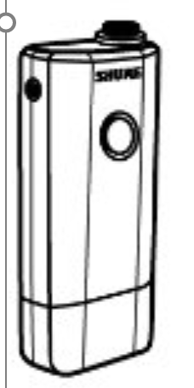
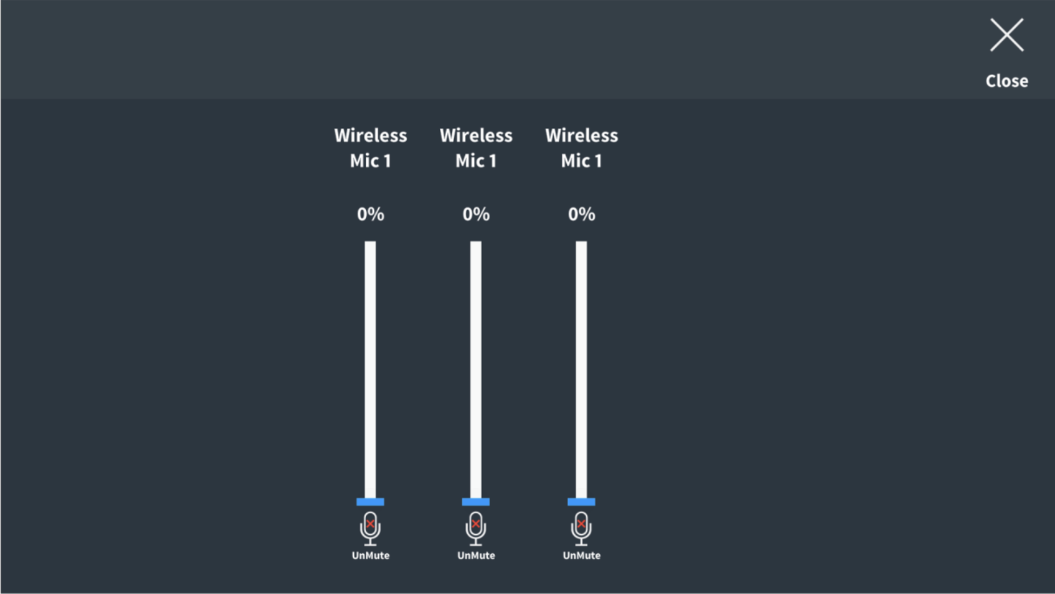
Shure MXW1-Z10 Microphone/Transmitter - Anatomy Lab
The Labs are packed with wearable microphone transmitters (2) on clips (lavalier). To use them, simply turn them on and make sure the device's volume is set appropriately under the Mic Controls windows on the Crestron panel.
Important: Don't forget to put the mics back on their chargers before you leave.

Slide 21
Crestron Controls for the Multipurpose Lab
The Crestron panel in this room accommodates four "Station" inputs – which are the BenQ interactive boards. One hangs on the front wall for the instructor and the other six around the cadaver stations. They are labeled to match the panel.
Note: It is best practices to click the red "Turn Room Off" button to reset the system for the next user.
Podium desktop
Clickshare devices
BenQ Interactive boards (4)
To learn more, click the QR code, or scan it with your mobile device camera.
Camera mix
A smaller, identical Crestron panel is located by the door.

Slide 22
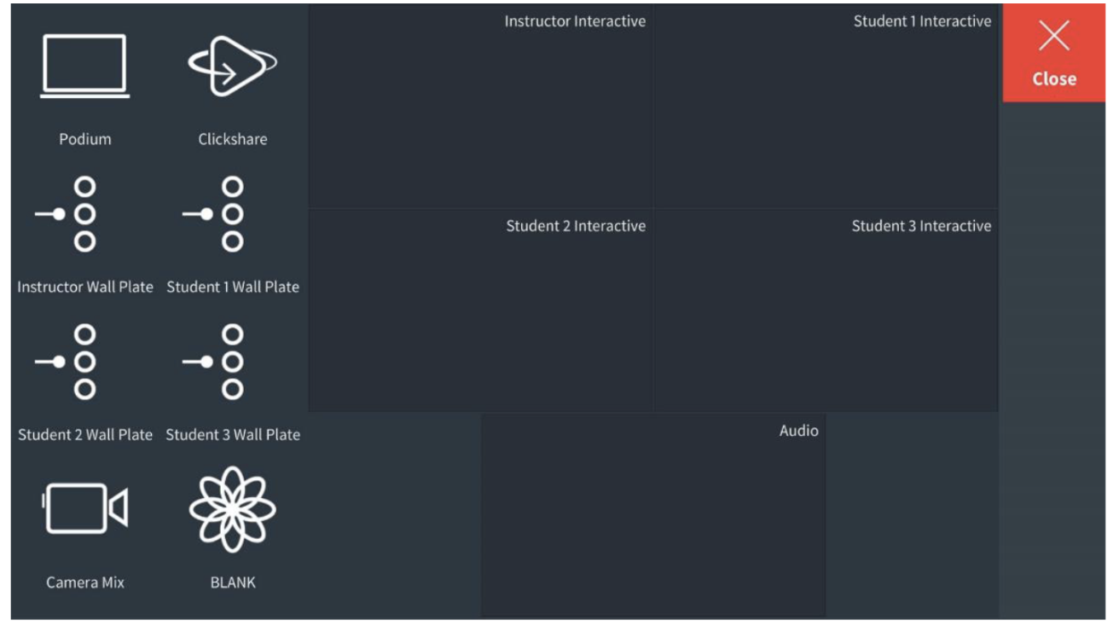
Crestron Controls for the Multipurpose Lab
When you select Manual Control button on the main Crestron screen, you open a window that allows you to simply drag and drop the input of your choice to the display of your choosing. For example, if you want to display the content of the doc cam, or visualizer, on all displays, simply drag the doc cam icon, located on the left, to all the displays as labeled on the right, one-by-one. If you change your mind about displaying the content on one of the devices, simply drag and drop it back in the device list. When you have made your selections, click “X Close” to go back to the main Crestron screen.
Devices
Displays
To learn more, click the QR code, or scan it with your mobile device camera.
A smaller, identical Crestron panel is located by the door.

Slide 23
WolfVision Doc Cam (VZ 9.4F) - Anatomy Lab
This room has been supplied with a WolfVision Doc Cam already connected
to the Crestron control panel
to easily share printed materials,
3D objects, a mobile device, etc.
To begin, be sure the Doc Cam is selected for sharing via the Crestron Control panel and lift up the Doc Cam arm.

Slide 24
Shure MXW1-Z10 Microphone/Transmitter - Multipurpose Lab
The Labs are packed with wearable microphone transmitters (2) on clips (lavalier). To use them, simply turn them on and make sure the device's volume is set appropriately under the Mic Controls windows on the Crestron panel.
Important: Don't forget to put the mics back on their chargers before you leave.

